Slide 1
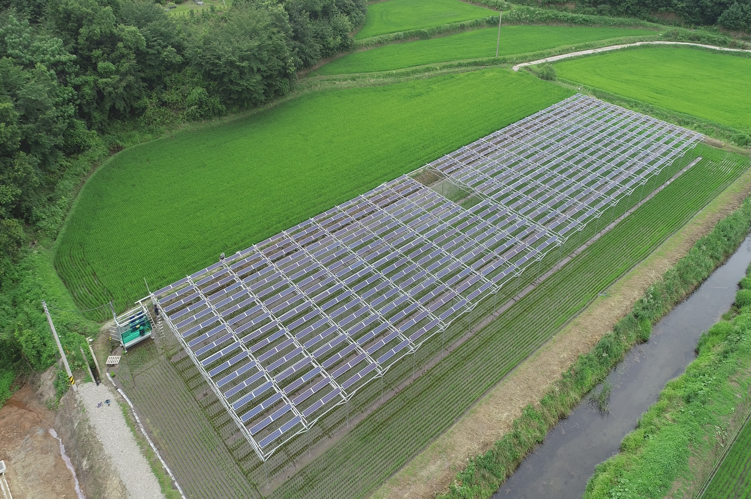
Digital Agriculture Workshop - World Bank
Agrivoltaic system case study
Aug. 28th, 2019

Slide 2
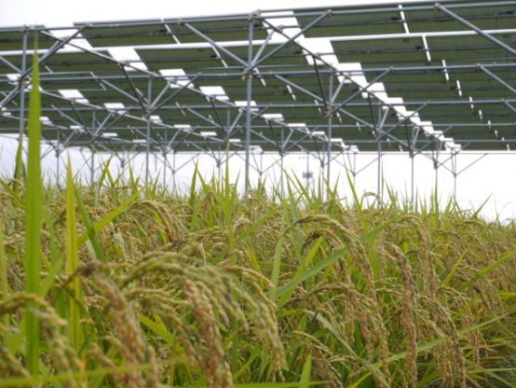
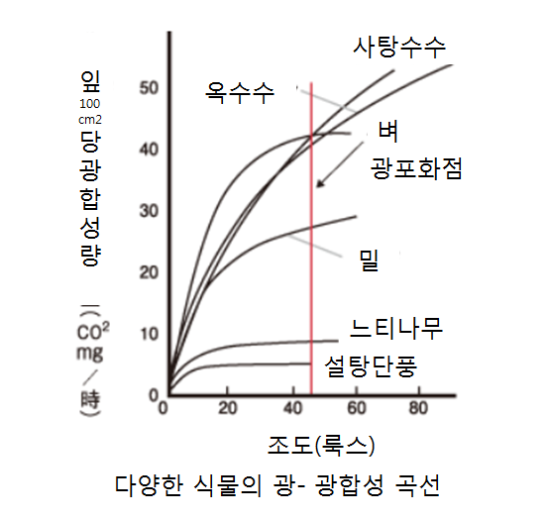
1. Definition of Agrivoltaic
Producing solar energy and crops on same farmland
Photovoltaic generation
Sun plant cultivation
사
조도(klx)
Solar sharing theory

Slide 3
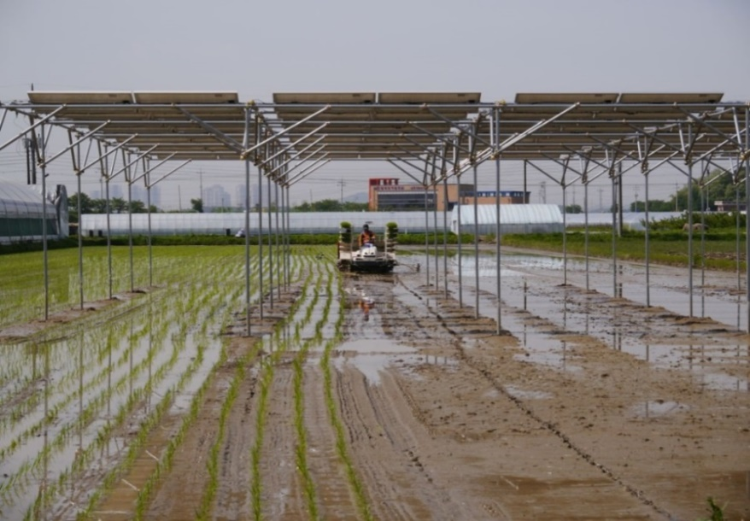
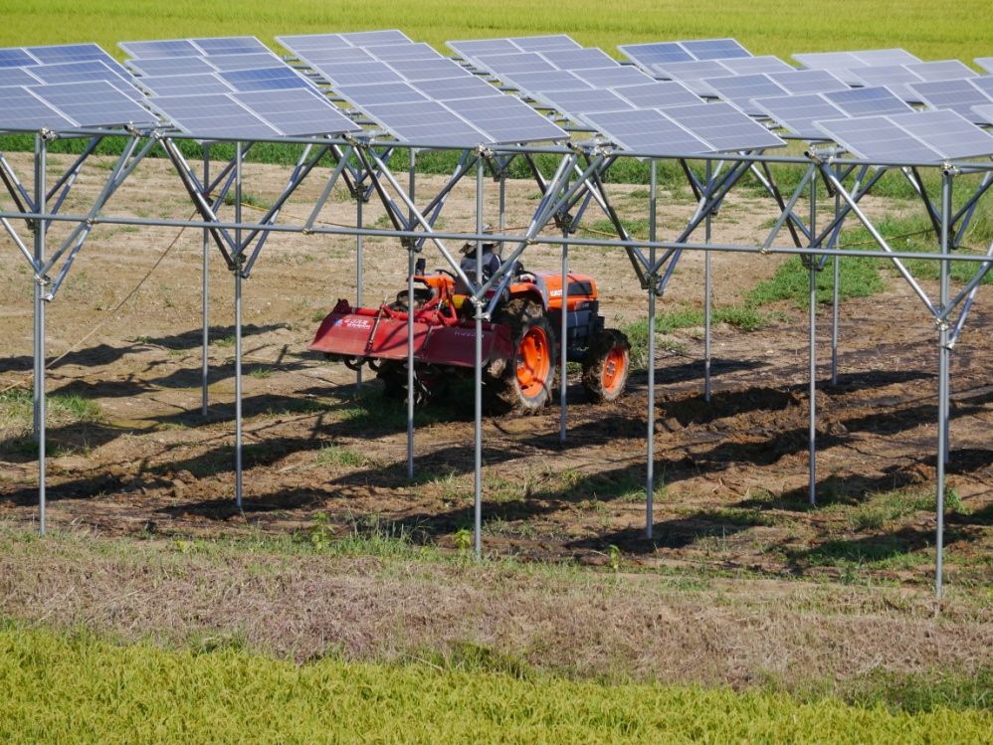
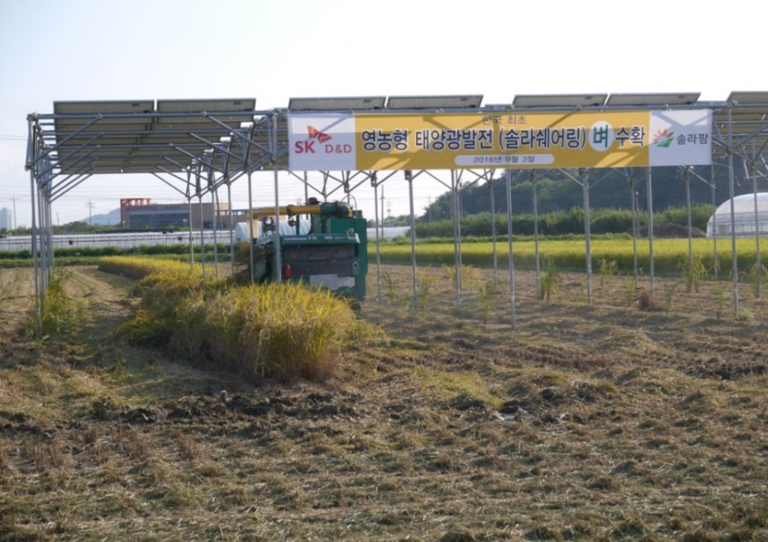
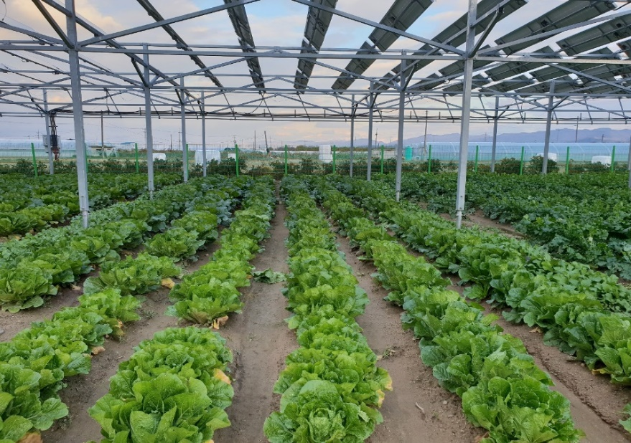
2. Agrivoltaic site examples
Korea’s first agrivoltaic rice paddy & farm field (2016, Cheongju Chungbuk)

Slide 4
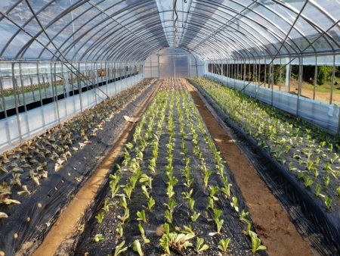
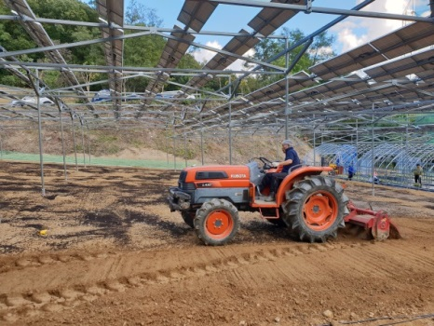
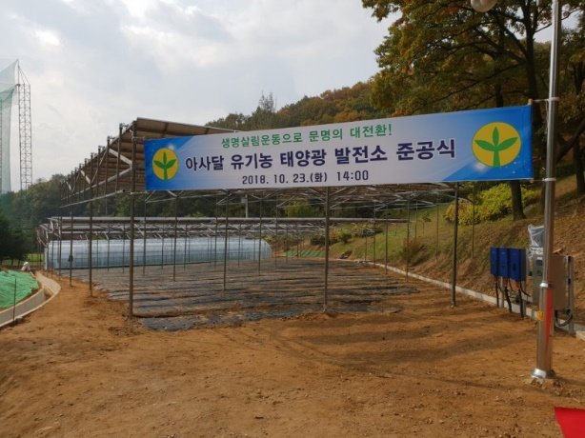
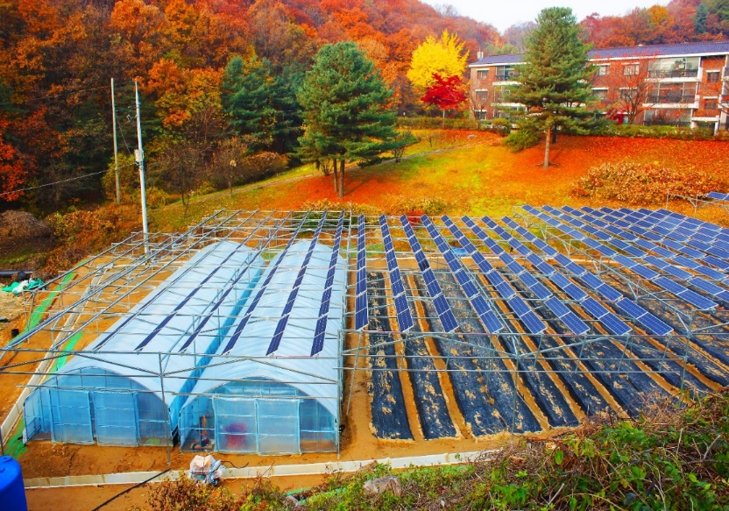
Field 70kW (Seongnam Gyeonggi)

Slide 5
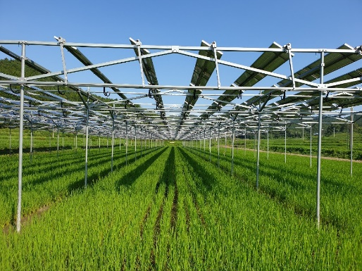
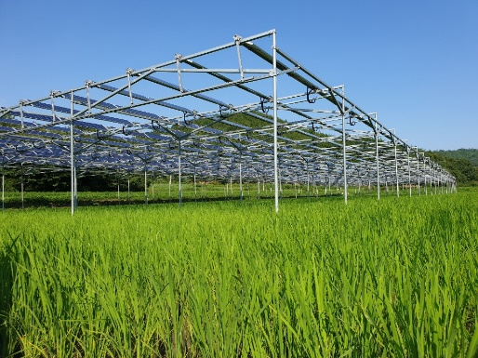
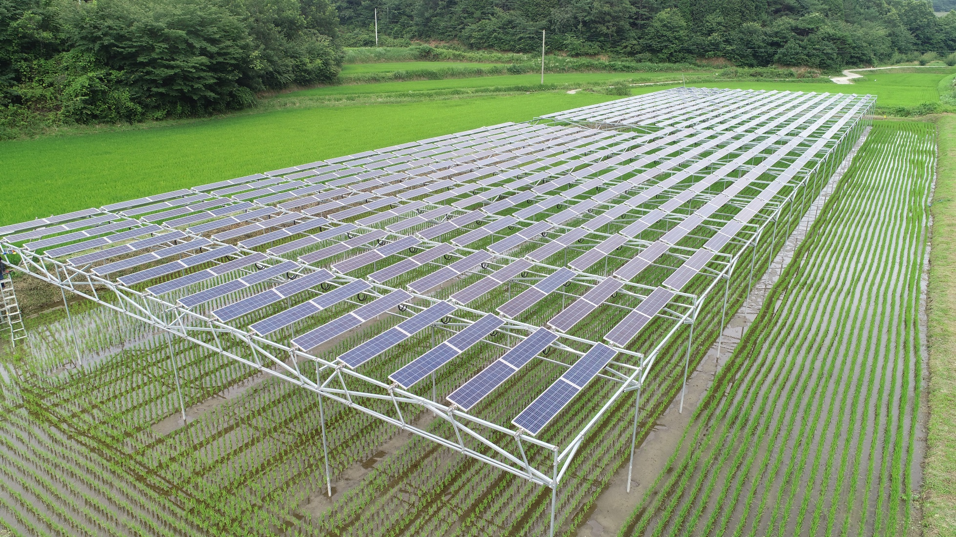
Rice paddy 99kW (Bosung Jeonnam)

Slide 6
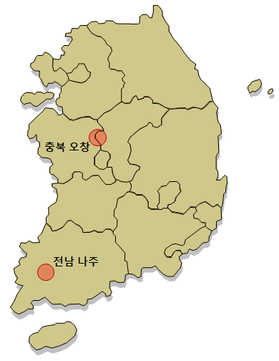
3. Agrivoltaic crop yield Result
Agrivoltaic standard : 20% yield reduction or less
- Rice, potato, Korean cabbage, Korean radish, sesame, onion, garlic
- Some crops show over 20% reduction, feed crops show increased yield
품종/감수율
Rice (Chungbuk)
- Koshihikari 20%
- Chuchung 12%
Potato (Chungbuk)
- Namjak (spring)16%
Korean Cabbage (Chungbuk)
- Betafresh 7%
Korean Cabbage (Jeonnam)
- Betafresh 11%
※ Yield reduction : yield comparison under same cultivation environment
※ Shading rate : 28~31.5%, solar panel : Halfsize (36Cell : 3×12, 4×9 type)

Slide 7
Farming is possible
Yield differs from structure design and crops/ farming technique
Agrivoltaic structure design
Dual cropping techniques
Built to generate solar energy and grow crops at the same time
Adapt new farming technique and suitable crops to each area for dual cropping
Shading rate
Panel size, arrangement
Panel control system
Structure material
Regional climate
Crop characteristic
Farming technology
Machinery usability

Slide 8
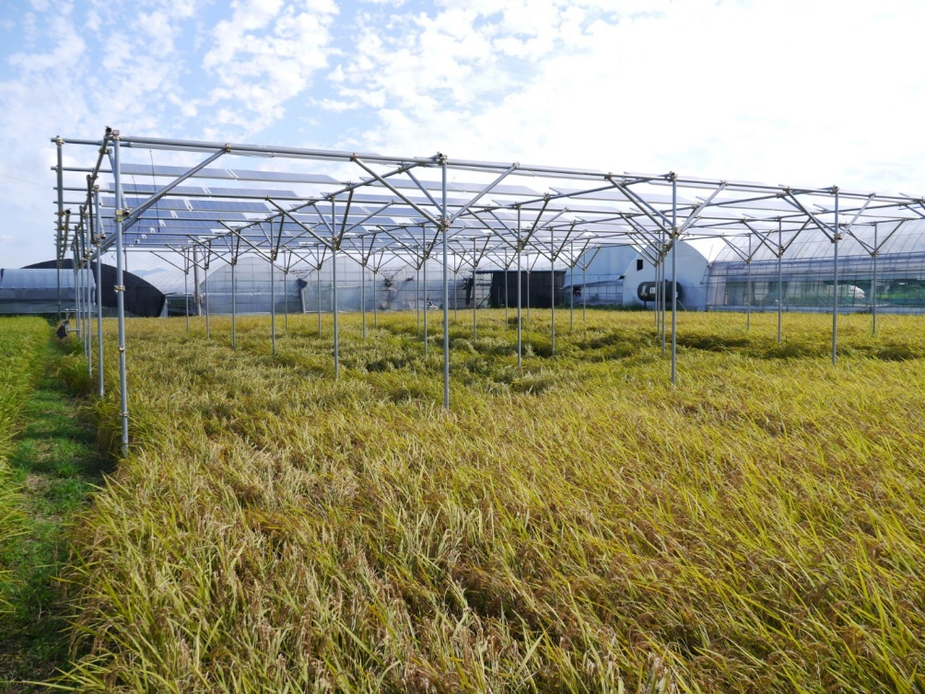
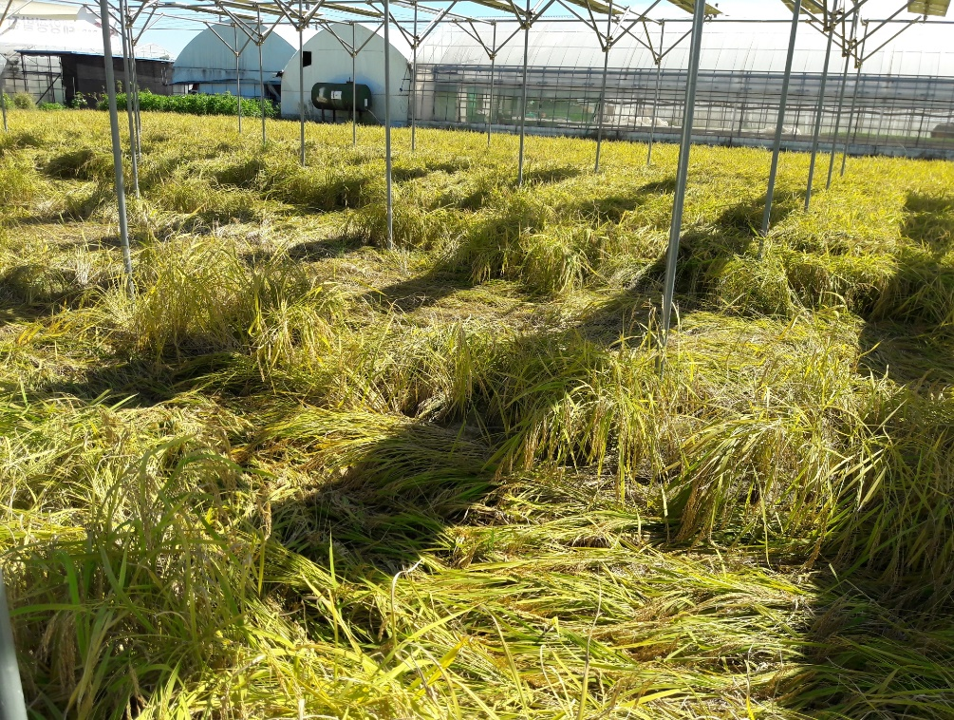
Lodging Example
- Rice(Koshihikari) : 2016, 2017, occurred both years
- Rice(Chuchung) : 2018, No lodging

Slide 9
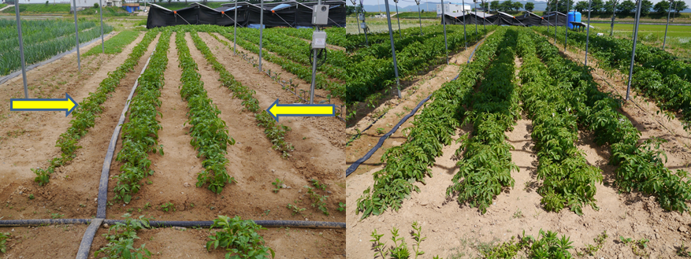
Effect of raindrop from panel at same shading rate)
- Potatoes : Cheongju Chungbuk, 2017
Effect of raindrop at same shading & sunshine rate

Slide 10
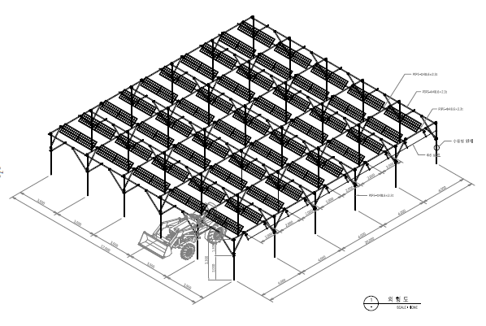
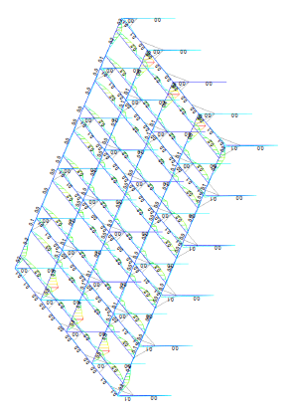
Structure design
- Shading rate = solar panel size ÷ total installation size, : less then 33% (sunlight)
- Structure, wind speed, machine workability, durability, module angle controller
- Materials : minimize crop and land pollution (heavy metal, concrete, chemicals)

Slide 11
Solar panel size and shape
- Change in sunlight, raindrop, wind speed (under same shading rate)
- Narrower panel width is better for farming (but higher construction cost)
6×12=72cell
4×9=36cell
3×12=36cell

Slide 12
4. Expected effect of agrivoltaic
Crop yield
Solar power generation
Farmland
Farmer
Maintain crop yield profit
(yield could decrease)
Non-farming profit over 10,000 USD/year
(2,000㎡, 100kW)
pension for old farmers
Maintain farmland, farming (1.5% of 1.7mil ha farmland with agrivoltaic)
Maintain farmers – support 100,000 farmhouses
(10GW of solar energy)
Agriculture industry
Society
Sustainable agriculture
Agriculture direct subsidy budget preservation
Renewable energy 3020 agenda achievable
(10GW of farm-solar energy)
Achieving sustainable agriculture and expending renewable energy simultaneously

Slide 13
Profitability analysis
- Depends on energy and agricultural policies
[Situation in Korea]
Subsidy on solar electricity
Electricity for farming is cheap
Transmission line is built
Limited land for solar power plant
Solar energy profit
Agriculture profit
Revenue $20,500/year
Profit $10,500/year
Initial self payment $21,882
Revenue $2,000/year
Profit $1,300/year
산출 근거
발전시간 3.6시간/일
FIT 판매단가 SMP + 1 REC = 184,393, 가중치 1.2 감안 시 202.4원/kW
SMP, REC는 ＇19년 소형태양광 고정가격계약 매입가격 적용(산자부공고제2018-22호)
20년 산술평균, 효율감소 0.7%/년, 안전관리비+보험료, 수선적립금 170만원/년
시설비 : 발전/개발인허가 포함 (토지대, 농지보전부담금, 개발부담금 제외), 시설비 1.8억원의 90%는 에너지공단의 1.75% 장기저리 대출 +계통연계비 850만원
농업수익 : 쌀 14가마/2,000㎡ × 17만원/가마(80kg) = 238만원/년, 농업 비용 제외
[Situation in Foreign Countries]
Need for dispersed generation
Cost reduction on farming structure and ICT construction, self-use of produced electricity
Compare production cost with other energy sources : Grid parity & transmission cost etc.

Slide 14
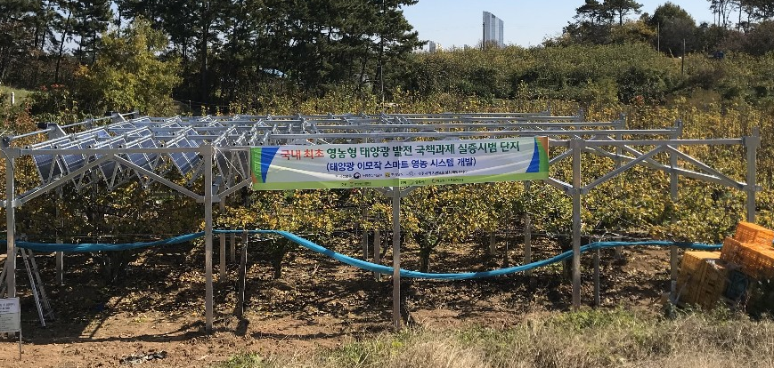
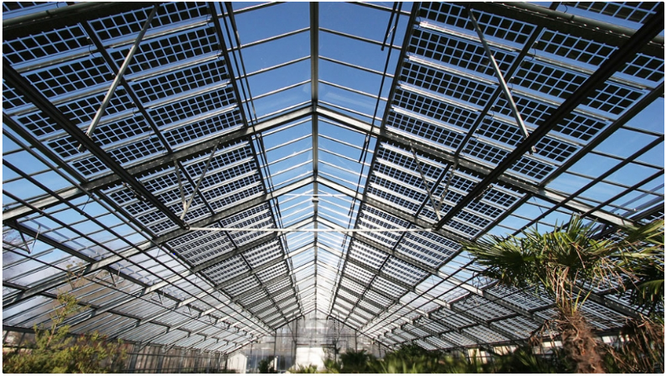
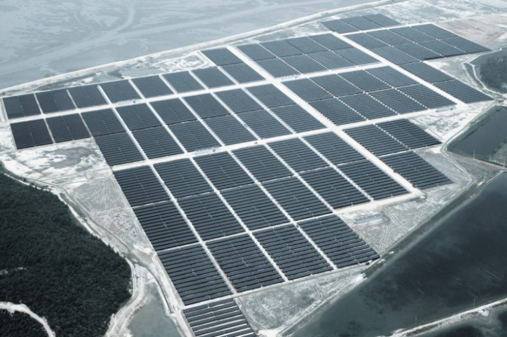
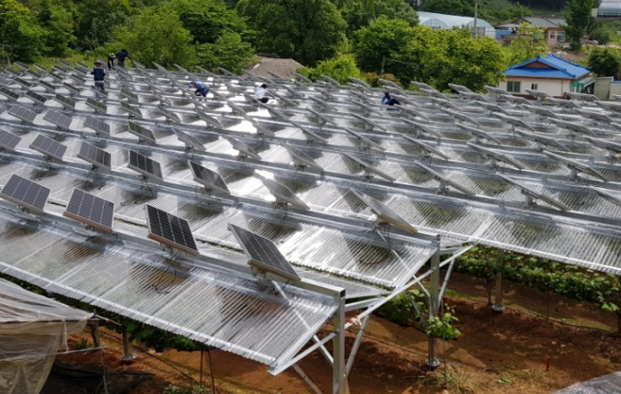
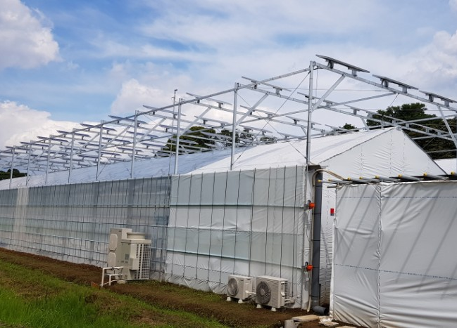
5. Development of agrivoltaic system
Development of new usage
- Land : orchard, salt pond, Ginseng
- Structure : greenhouse, vinyl greenhouse, drying rack

Slide 15
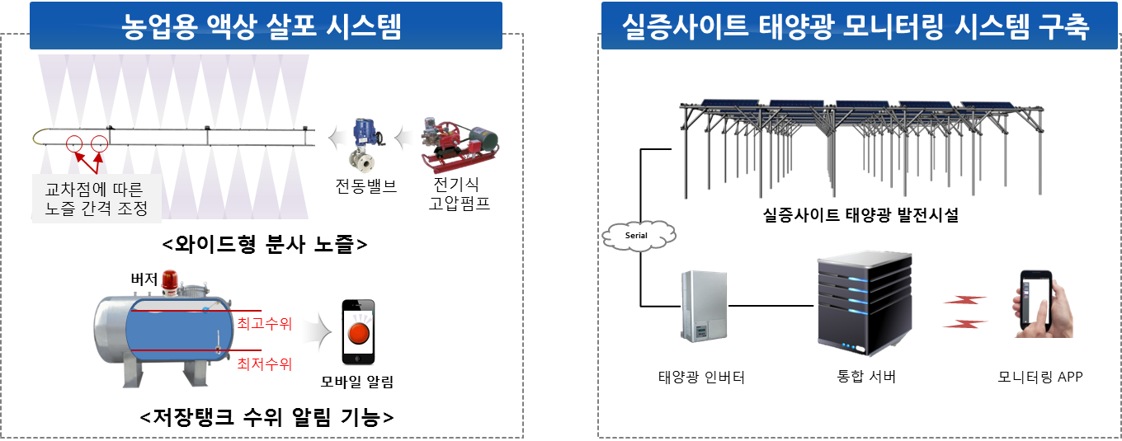
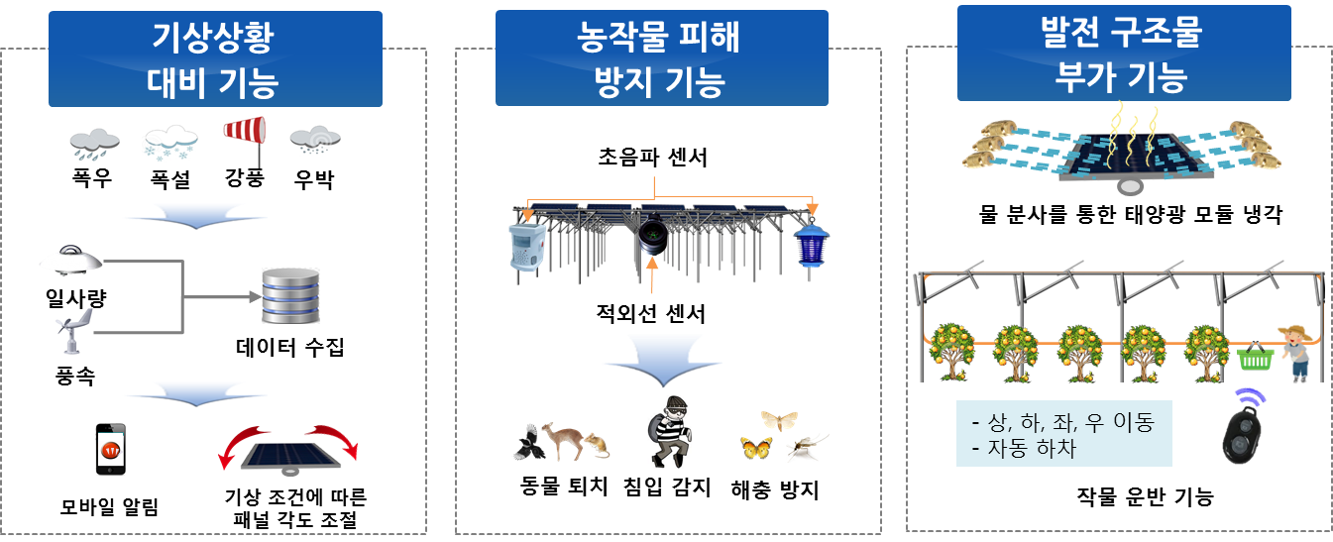
ICT (Information & Communication Technologies), smart control technology
Fertiliser sprinkling system
Energy production monitoring system
Climate check & preperation
Crop damage prevention
Extra functions to the structure

Slide 16
6. SolarFarm introduction
Korea’s first agrivoltaic farming
Participating in government projects & possess largest agrivoltaic references
Expert in organic farming and horticulture
Agrivoltaic consulting and construction
Member of Korea Agrivoltaic Association(KAVA)
Education
Business presentation
education
Communication window for farmers
Post management
Agriculture management
Structure compatibility management
Agrivoltaic status & data report
Policy
Policy and regulation consulting

Slide 17
Thank you!
solarfarm@solarfarm.co.kr www.solarfarm.co.kr

